Slide 1
Ontologies in biology, biomedicine and disease genetics

Slide 2
The problems with biological data
Recorded mainly in natural language. E.g. mutant phenotypes
  Language uses symbols and rules (natural language) to communicate knowledge
  Expressive
  Semantically ambiguous
  Hard to compute on
Computational language
  Precise
  Less expressive
  Allows grouping and data exploration
Why do we need to compute?
  Database searching, query extension
  Data/Literature mining
  Knowledge transfer between databases and analytical packages
  Complex queries
  Data integration
  Reasoning
  Machine learning

Slide 3
The naming of things...
Naming and classification are essential for the capture and use of knowledge about the world.
Names (labels) are a common reference that can be used by everyone to refer to the same entity
Labels can be attached to many things
  Physical entities in the real world
  Concepts
  Processes
  Qualities
  Relationships

Slide 4
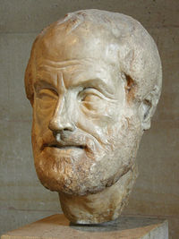
The naming of things...
Aristotle (384-322 BC)
First systematic taxonomy of biology,
Classification of organisms by shared properties and value-based hierarchy
Binomial genus-differentia nomenclature
Galen (130-210 AD)
Systematic description of diseases, signs and symptoms.
In De Febrium Differentia description of fever symptoms he uses the terms Intermittent, remittent and intermittent fevers adopting the Aristotelian genus-differentia approach

Slide 5
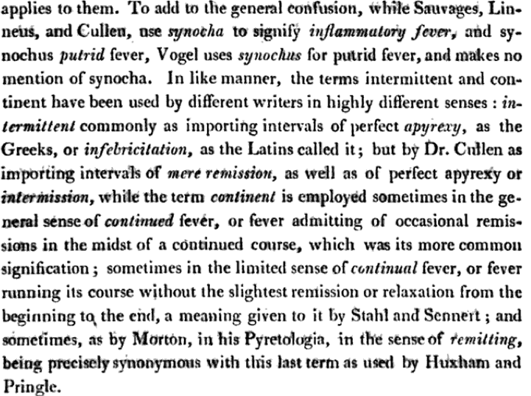
A physiological system of Nosology.....John Mason Good 1820

Slide 6
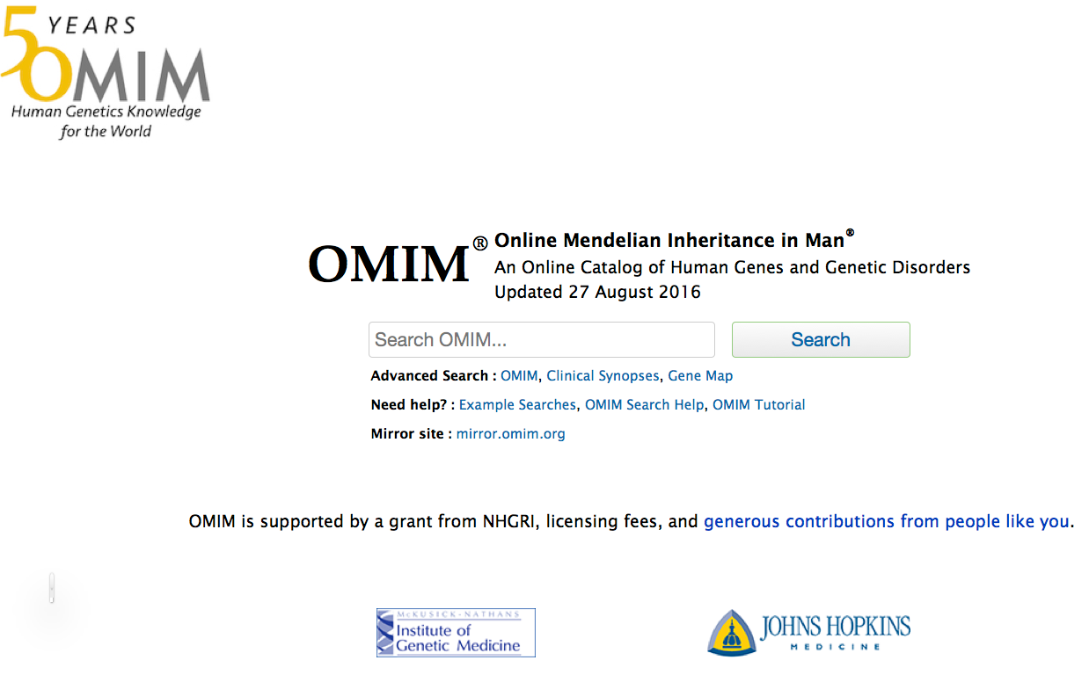
The problem hasn’t gone away....
OMIM Query | # Records
“large bone” | 785
“enlarged bone” | 156
“big bone” | 16
“huge bones” | 4
“massive bones” | 28
“hyperplastic bones” | 12
“hyperplastic bone” | 40
“bone hyperplasia” | 134
“increased bone growth” | 612

Slide 7
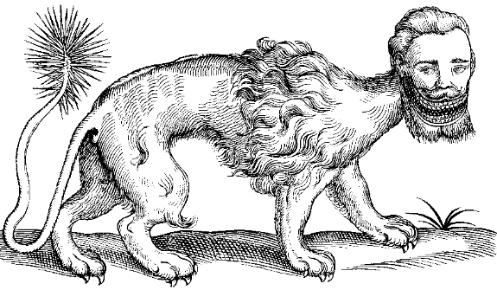
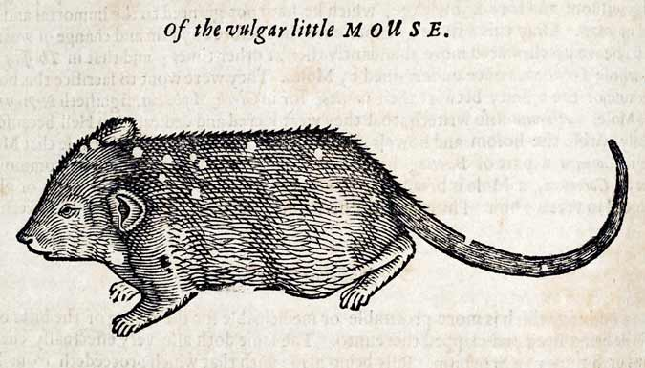
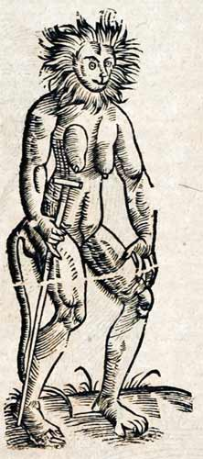
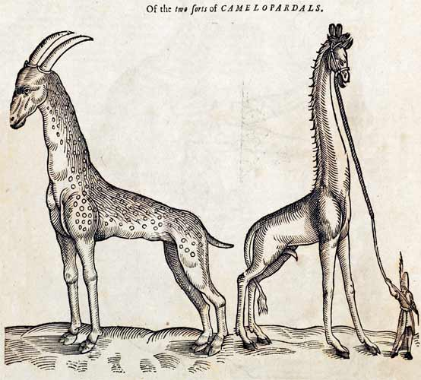
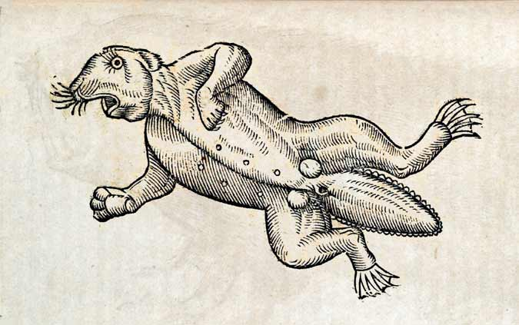
Classification systems
1. those that belong to the Emperor,
2. embalmed ones,
3. those that are trained,
4. suckling pigs,
5. mermaids,
6. fabulous ones,
7. stray dogs,
8. those included in the present classification,
9. those that tremble as if they were mad,
10. innumerable ones,
11. those drawn with a very fine camelhair brush,
12. others,
13. those that have just broken a flower vase,
14. those that from a long way off look like flies.
The Celestial Emporium of Benevolent Knowledge Borges

Slide 8
Lessons
Systematic, meaningful and unambiguous nomenclature is important in handling concepts
The definitions of terms is as important, if not more so, than the terms themselves

Slide 9
Turning data into knowledge through concept relationships
Ontologies
Capture a shared understanding of a domain of interest
Provide a formal and machine manipulable model of the domain linking concepts through defined and scientifically meaningful relationships
Contain semantic links between concepts.
  eg. is_a, part_of, descended_from, has_symptom
The scientific knowledge implicit in an ontology can make the reasons for classification explicit using reasoning, and can detect errors.

Slide 10
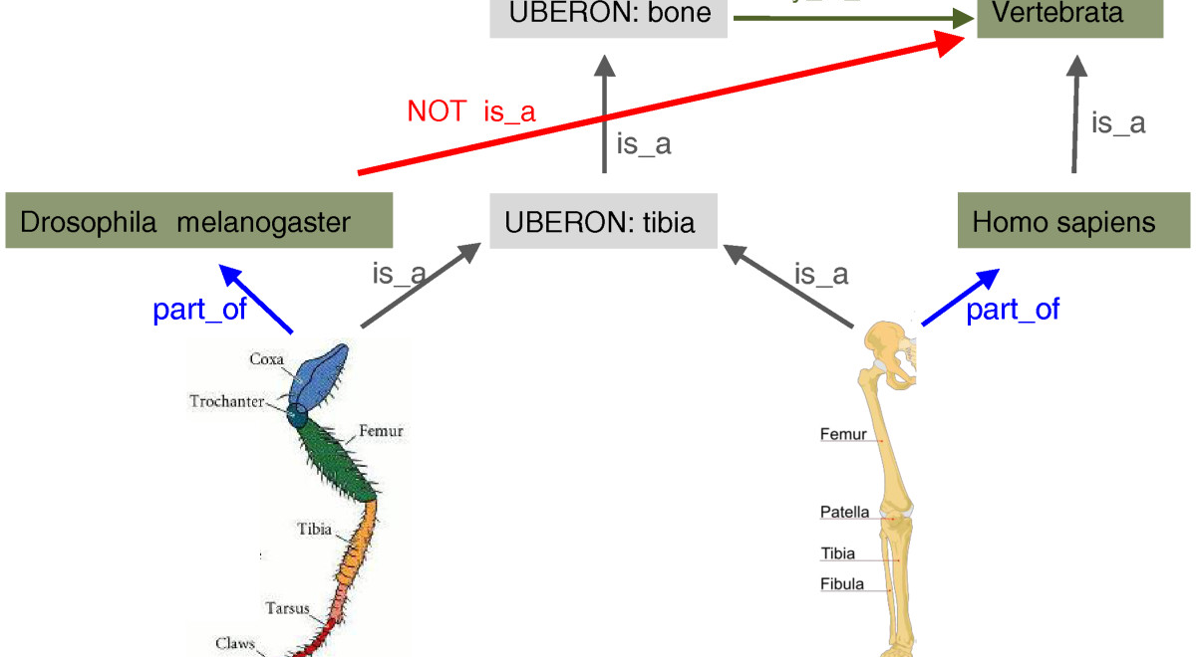
Detection of incorrect assertion by reasoning
Genome Biology 201213:R5

Slide 11
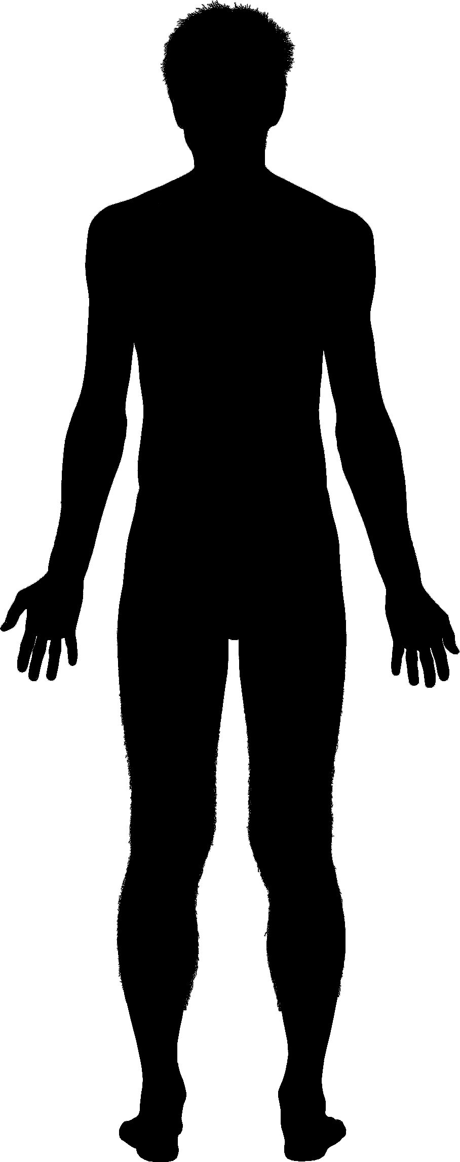
Functional Genomics
Understanding the link between –
DNA sequence Biology/Disease
(Genotype) (Phenotype)
Modifiers
Environment
Drugs
ATTCGCATGGACC
C
A

Slide 12
Sources of phenotype/genotype information
Mouse
Human
Mouse Genome Informatics
  >8800 genes have phenotype annotations in the mouse
Phenome DB
  1300 strains to date
Europhenome
International Mouse Phenotyping Consortium
  >3,575 strains systematically phenotyped to date
OMIM
  3100 phenotype descriptions with molecular basis known
  3600 phenotype description or locus with basis unknown
Orphanet
  6000 diseases with phenotype descriptions
dbGaP
ClinVar
GWAS central
GWAS catalog

Slide 13

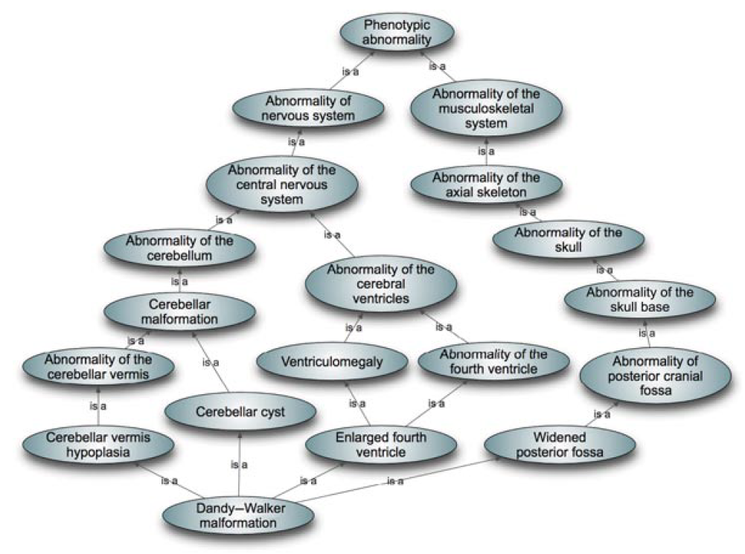
Main ontologies for diseases and phenotypes
Mammalian Pathology (MPATH)
  900 terms
  mapped to other terminologies
  describes pathological lesions and processes
Disease Ontology (DO)
  About 9000 terms
  Semantically mapped to major terminologies, UMLS, MeSH, ICD10 etc.
Experimental Factor ontology (EFO)
  “application ontology”18596 terms
  Imports classes from other phenotype and related ontologies (MIREOT)
Orphanet Ontology (ORDO)
  13105 terms
  structured vocabulary for rare diseases capturing relationships between diseases, genes and other relevant features
Human Phenotype Ontology ( HPO )
  15, 319 terms
  derived from OMIM clinical synopses
Mammalian Phenotype Ontology (MP)
  11, 720 classes
  Used by MGI for annotating mutant strains from literature
  Used by IMPC for annotating phenotyping pipleline
Unified Medical Language System (UMLS)
  US National Library of Medicine
  terminology, classification and coding standards
  8M normalised concepts
SNOMED-CT
  321,000 classes
  clinical terminology
  diseases diagnostics and procedures
  proprietary
NCI thesaurus
  119,000 classes
  vocabulary for clinical care, translational and basic research, and public information and administrative activities.
LOINC
  medical diagnositics and observations
  180, 000 classes
ICD-10
  12,450 classes
  disease, epidemiology, billing
  soon to be replaced with ICD-11

Slide 14
Current anatomy ontologies
Ontology | Domain and applicability | Class count | Object Properties Count | Axioms count | Text definitions Count | Computable definitions Count | Text definitions % | Computable definitions %
Uberon | Animalia | 14773 | 150 | 226887 | 11229 | 5190 | 76.01% | 35.13%
FMA | Homo sapiens (A) | 78977 | 7 | 484774 | 1118 | 0 | 1.42% | None
EHDAA2 | Homo sapiens (AE) | 2734 | 9 | 24773 | 234 | 0 | 8.56% | None
MA | Mus (A) | 3257 | 1 | 19591 | 0 | 0 | None | None
EMAPA | Mus (E) | 6239 | 9 | 54307 | 77 | 0 | 1.23% | None
ZFA | Danio rerio (zebrafish) (AE) | 3147 | 8 | 35497 | 2528 | 0 | 80.33% | *None
TAO | Teleosti (bony fishes) (AE) | 3372 | 19 | 24109 | 1988 | 20 | 58.96% | 0.59%
XAO | Xenopus (frog) (AE) | 1521 | 6 | 16840 | 1492 | 0 | 98.09% | None
AAO | Amphibia (A) | 1603 | 34 | 7846 | 0 | 0 | None | None
FBbt | Drosophila (fruitfly) (AE) | 9951 | 46 | 115964 | 9072 | 2767 | 91.17% | 27.81%
WBbt | C. elegans (nematode) (AE) | 7601 | 6 | 56114 | 6551 | 11 | 86.19% | 0.14%

Slide 15
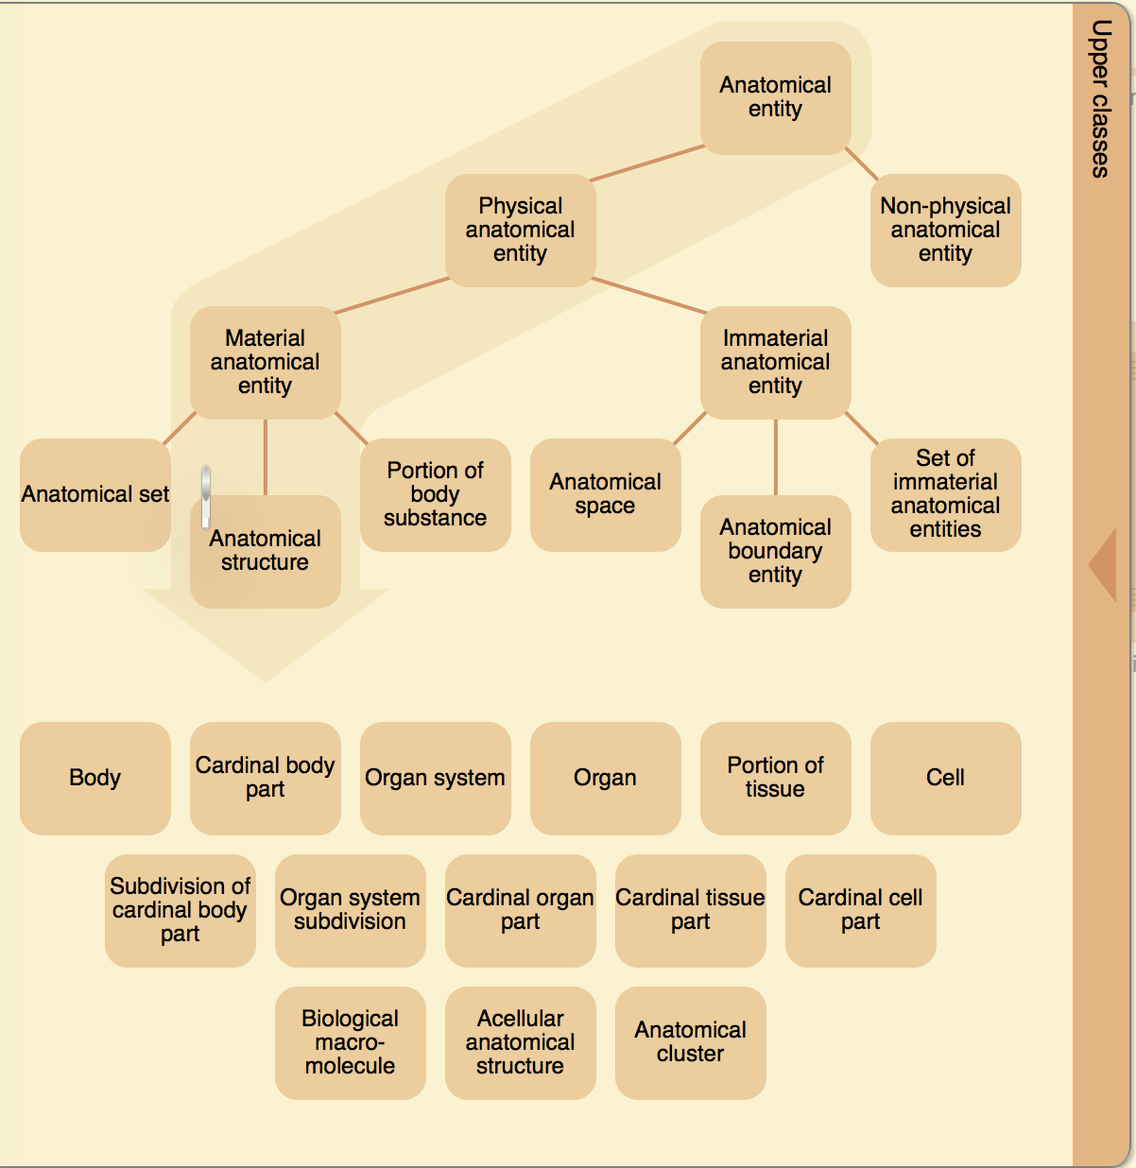

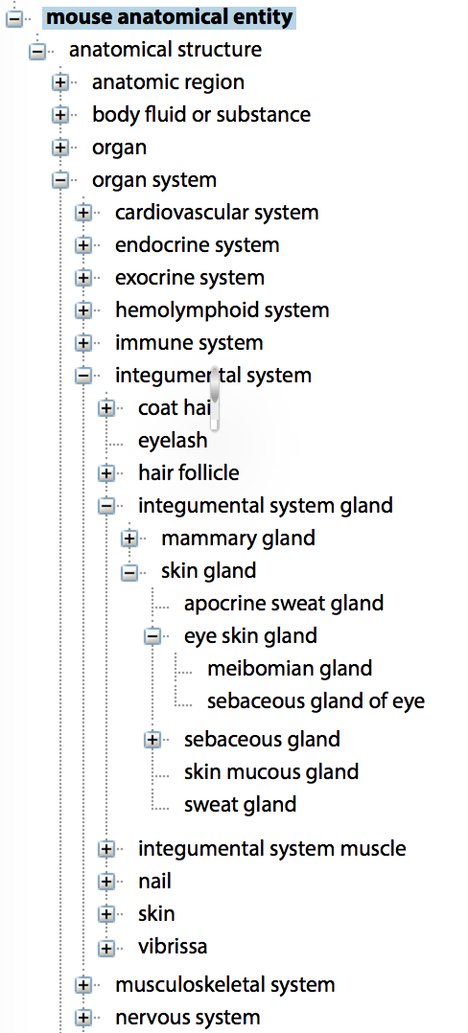
Anatomy ontologies

Slide 16
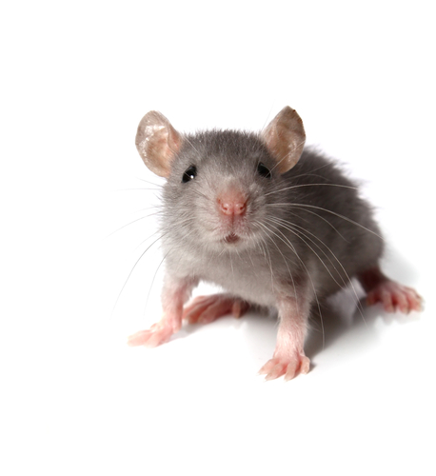
Main applications of ontologies in biomedical data
Annotation of genes, genetic variants
Annotation of disease entities
Data recovery, integration and analysis
  literature, EMRs and databases
Patient/animal data capture
Genome-Phenome relationships
  Overrepresentation analysis of phenotypes on patient or animal cohorts
  Correlation between variants and phenomes, eg in CNV analysis
  Establishment of disease similarity, phenotype modularity, network identity, through constituent phenotypes.

Slide 17
Main applications of ontologies in biomedical data
Annotation of genes, genetic variants
  OMIM, Orphanet, GWAS Catalog, Mouse Genome Informatics, Zfin, CLINVAR,
Annotation of disease entities
  OMIM, ORPHANET, Human Phenotype database (HPO), Aber-OWL-disease
Data recovery, integration and analysis
  Literature, EMRs, and databases
Patient/animal data capture
  Phenotips/Phenome central
  International Mouse Phenotyping Consortium (IMPC)
  Mouse Genome Informatics
Genome-Phenome relationships
  Overrepresentation analysis of phenotypes on patient or animal cohorts
  Correlation between variants and phenomes, eg in CNV analysis
  Establishment of disease similarity, phenotype modularity, network identity, through constituent phenotypes.

Slide 18
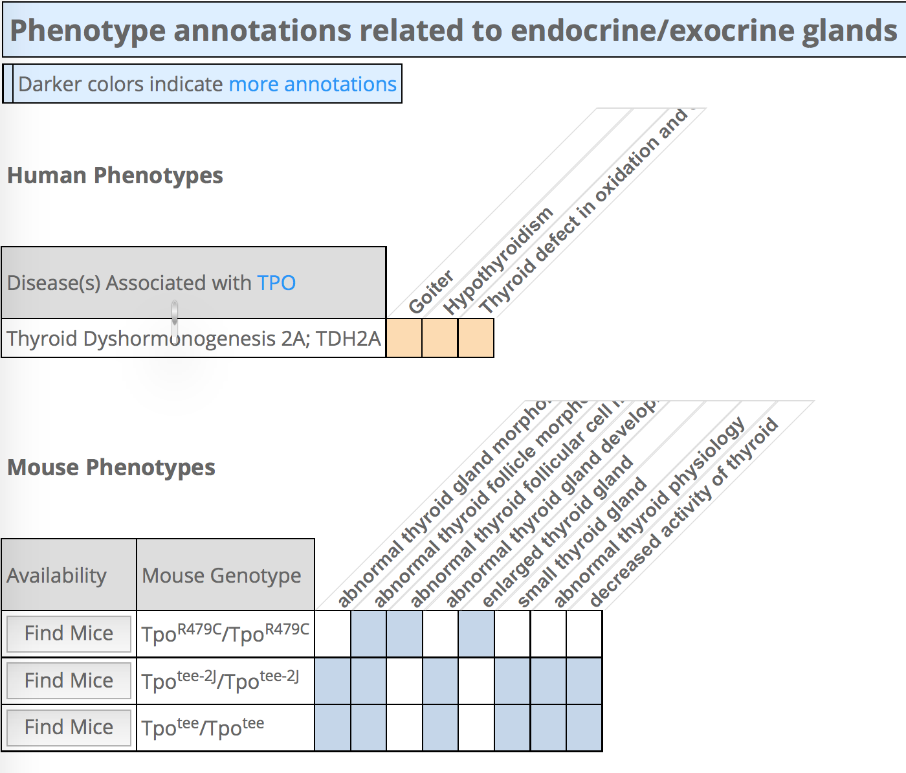
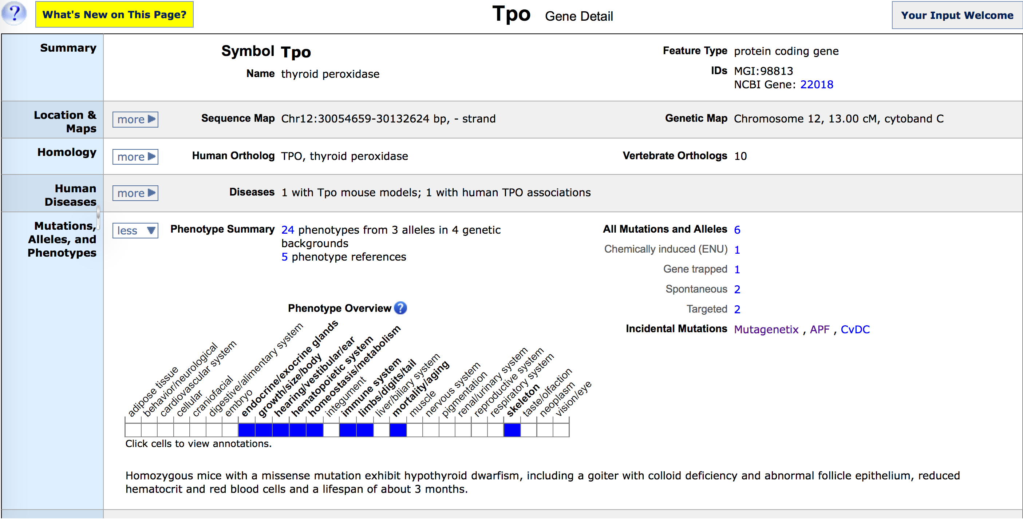
Phenotypes and diseases in MGI

Slide 19
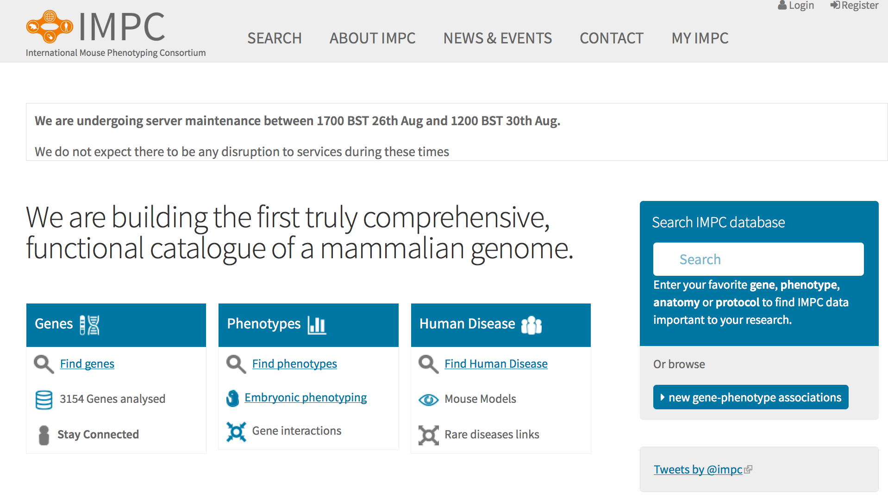
Phenotypes in IMPC

Slide 20
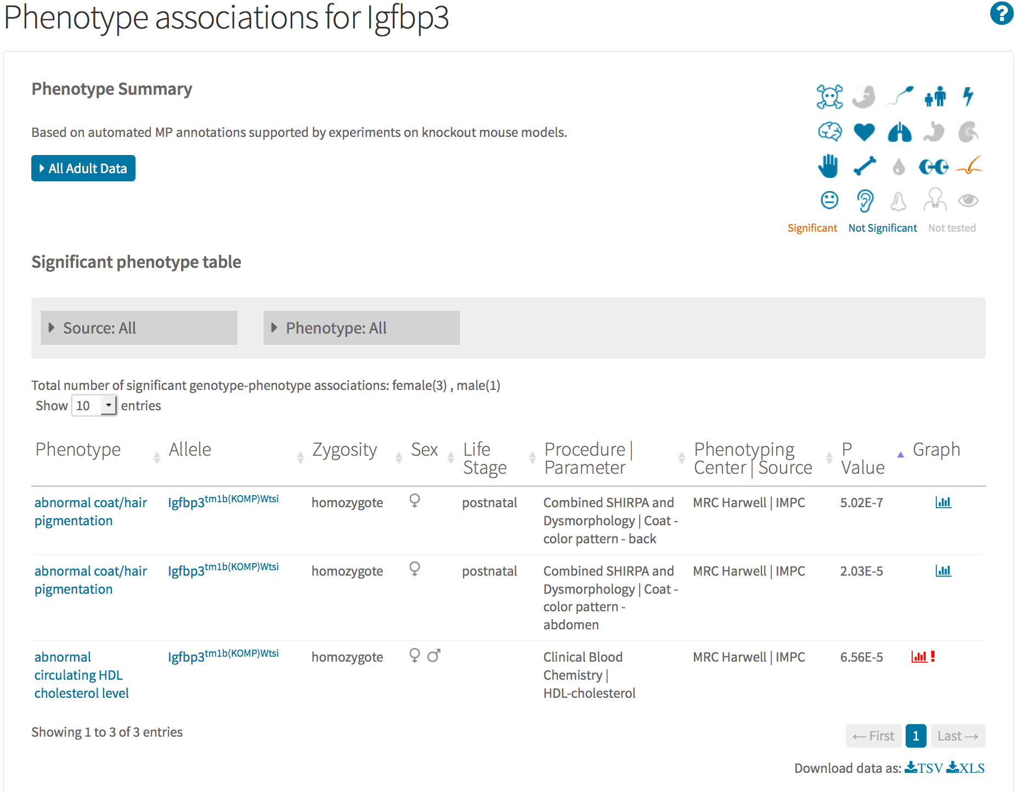
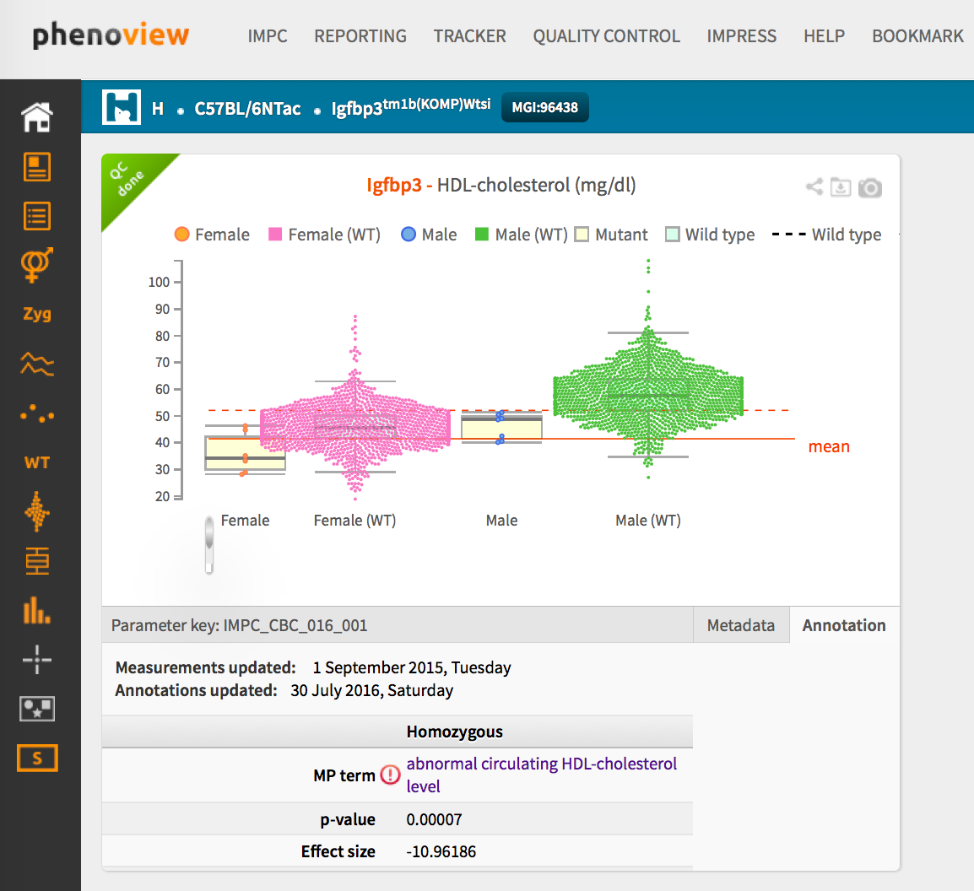
Phenotypes in IMPC

Slide 21
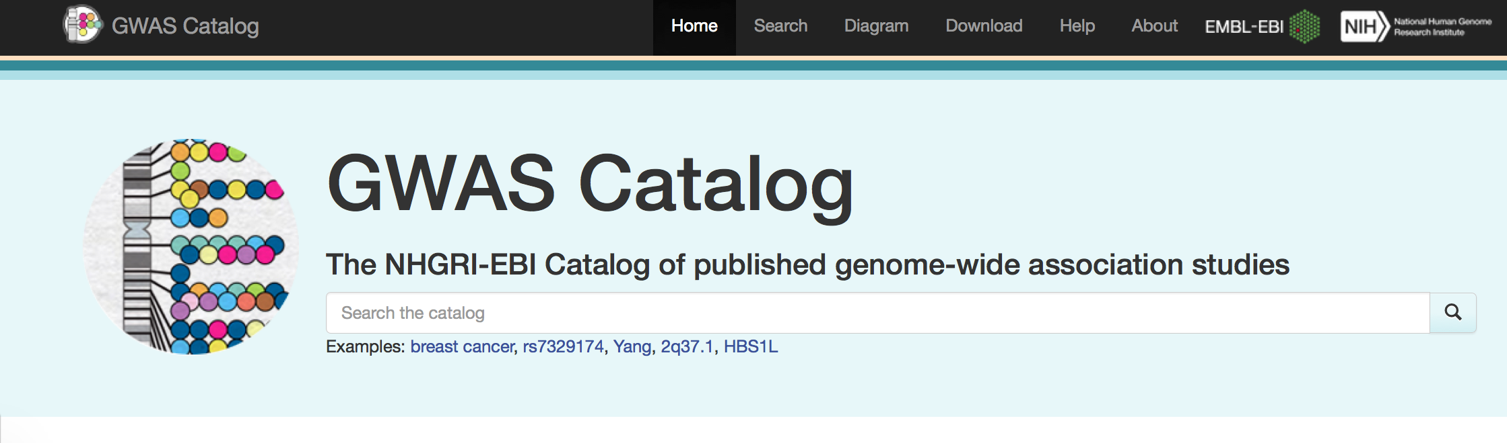
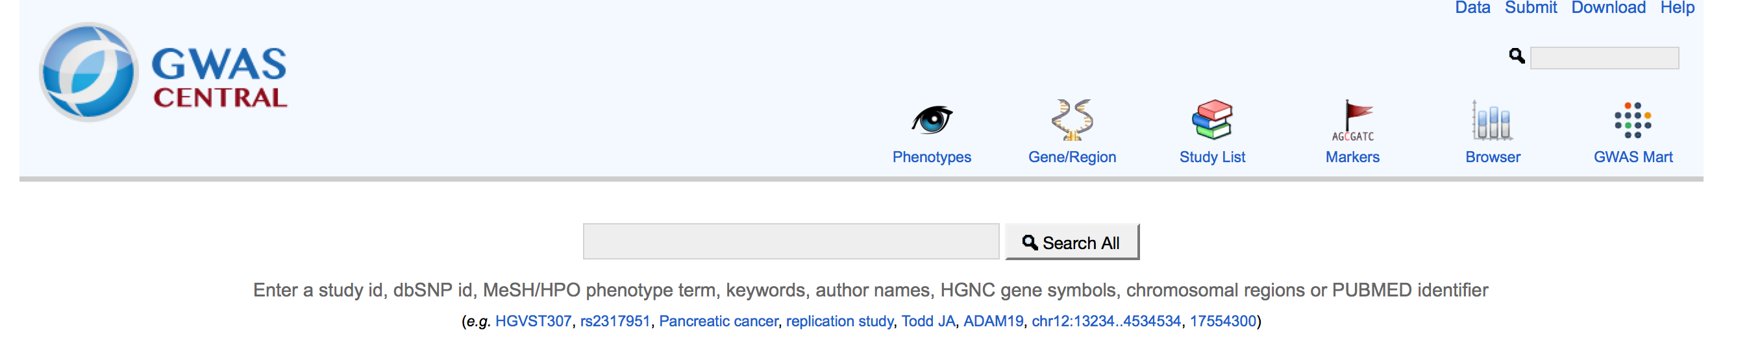
GWAS phenotypes traits and diseases
GWAS study traits annotated using the Experimental Factor ontology in Catalog
Used for many of the databases at EBI
Application Ontology
Imports classes from other ontologies across a wide range of themes using MIREOT
GWAS study traits annotated to MeSH or HPO in GWAS Central

Slide 22
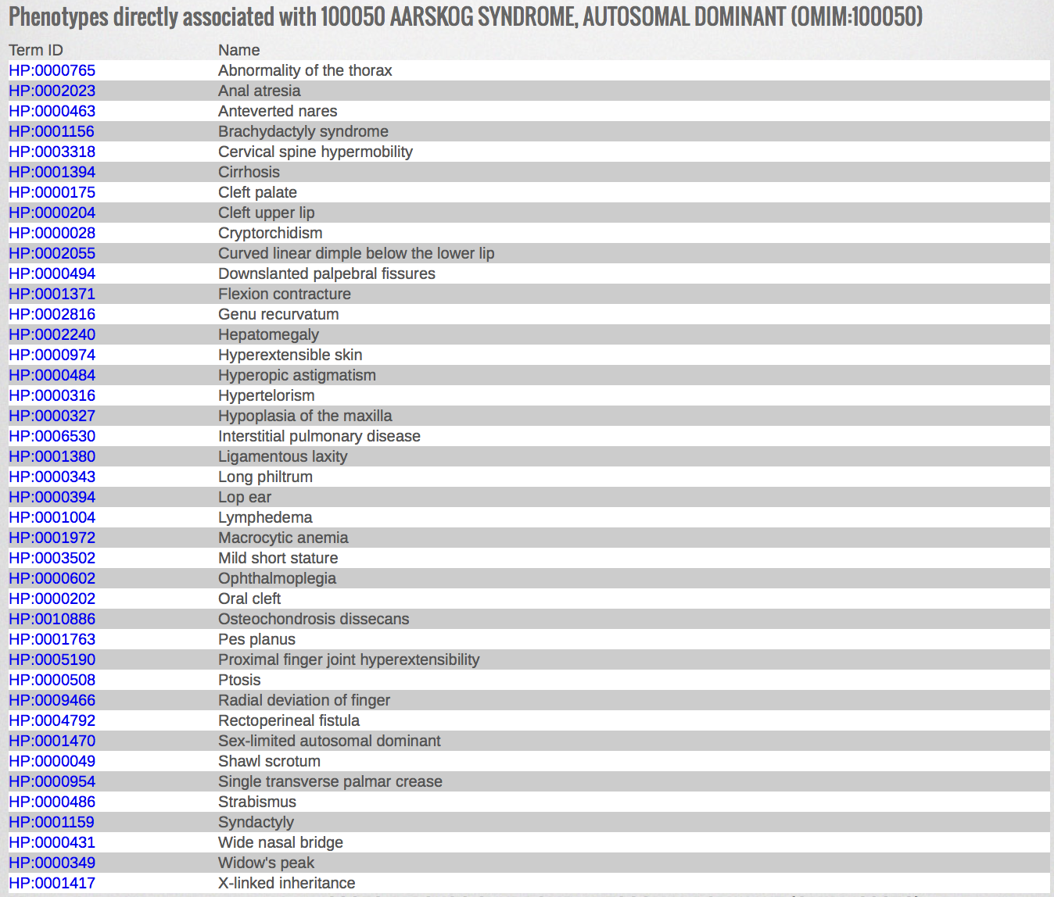
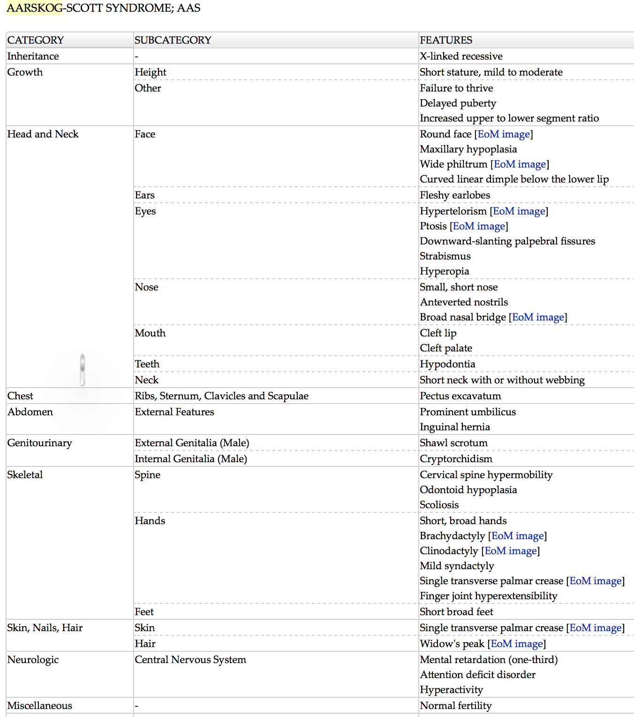
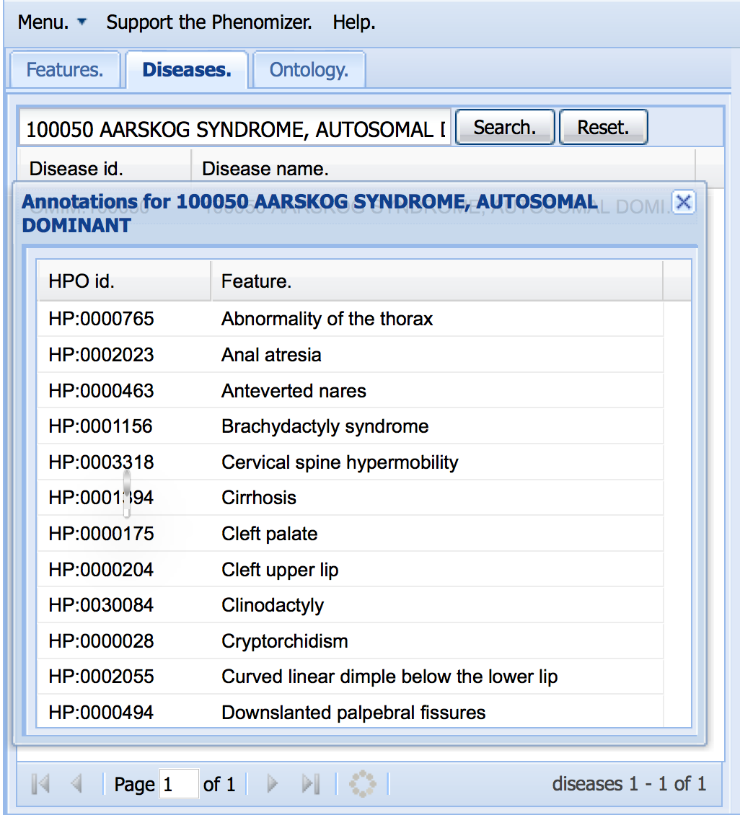
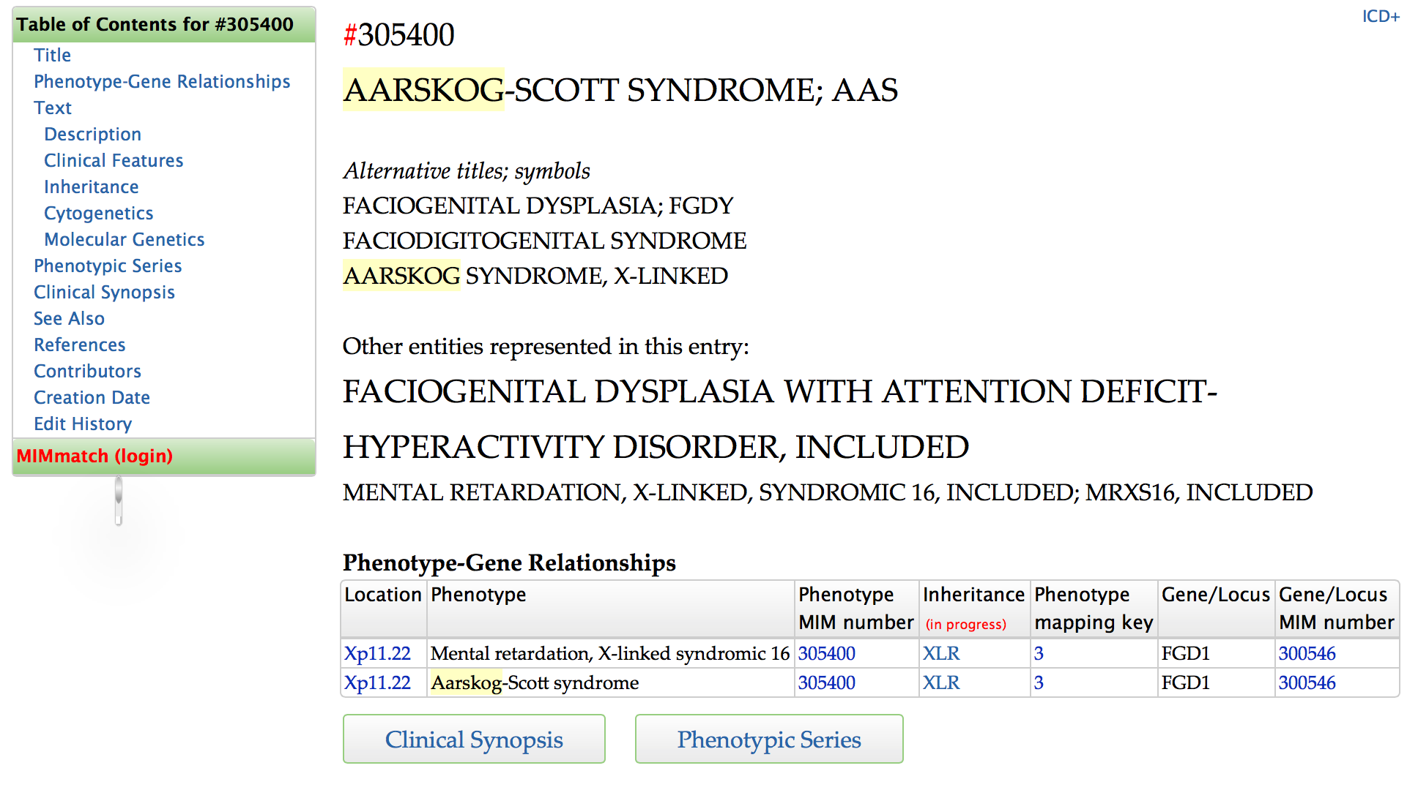
OMIM
PhenomeNET
Phenomizer

Slide 23
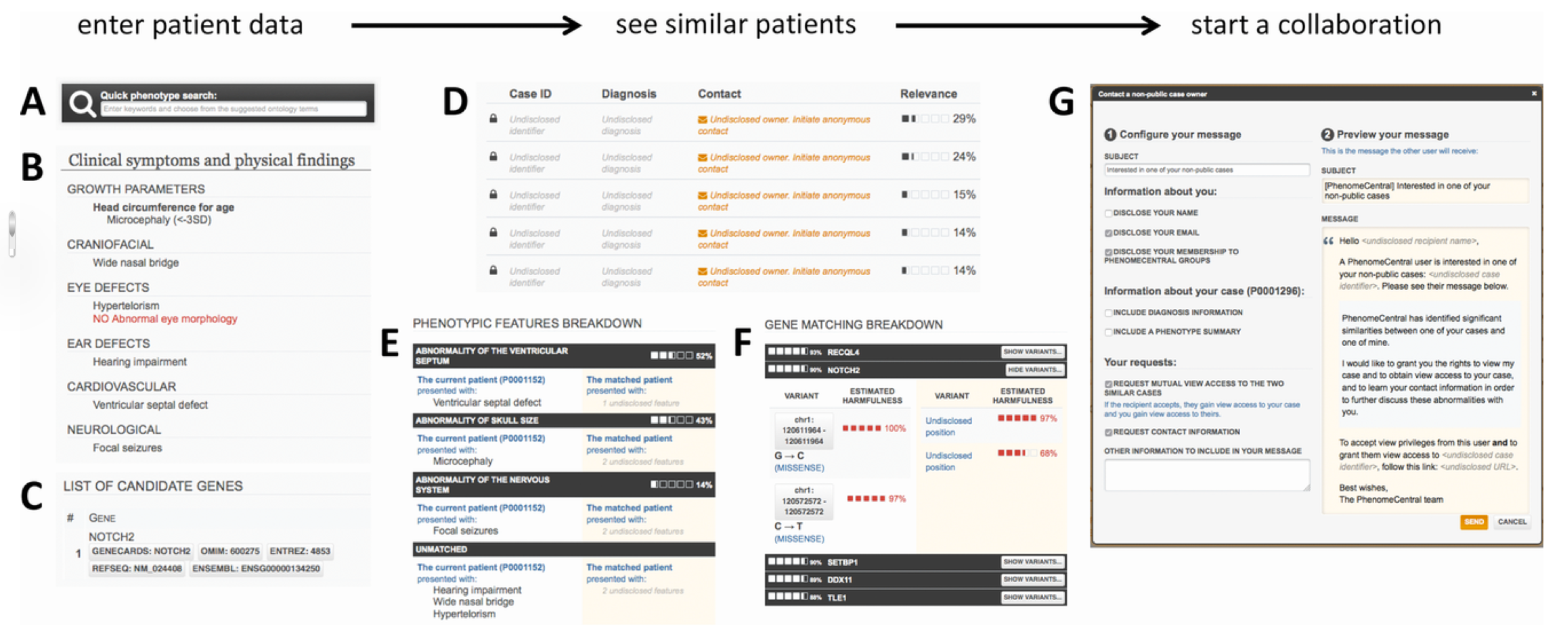
PhenomeCentral: A Portal for Phenotypic and Genotypic Matchmaking of Patients with Rare Genetic Diseases
Human Mutation
Volume 36, Issue 10, pages 931-940, 31 AUG 2015 DOI: 10.1002/humu.22851
http://onlinelibrary.wiley.com/doi/10.1002/humu.22851/full#humu22851-fig-0001
Notes:
Finding similar patients in PhenomeCentral. Patient data can be contributed to PhenomeCentral through the PhenoTips user interface, including the phenotype quick search box that enables rapid entry of phenotype terms from the HPO (A), or selected records can be automatically deidentified and transferred from any PhenoTips instance automatically. The patient record can contain both present and absent phenotypic features (B) as well as genetic information, including candidate genes and VCF files (C). The patient's features are then immediately compared with all other patients in PhenomeCentral (D), and the best matches are shown to the user. A detailed breakdown of the phenotypic (E) and genotypic (F) similarity is shown for each match, enabling the user to see the underlying reasons for the match and determine whether or not the match is worth following up. A customizable email template (G) facilitates contacting the (potentially undisclosed) submitter of another patient record.
IF THIS IMAGE HAS BEEN PROVIDED BY OR IS OWNED BY A THIRD PARTY, AS INDICATED IN THE CAPTION LINE, THEN FURTHER PERMISSION MAY BE NEEDED BEFORE ANY FURTHER USE. PLEASE CONTACT WILEY'S PERMISSIONS DEPARTMENT ON PERMISSIONS@WILEY.COM OR USE THE RIGHTSLINK SERVICE BY CLICKING ON THE 'REQUEST PERMISSIONS' LINK ACCOMPANYING THIS ARTICLE. WILEY OR AUTHOR OWNED IMAGES MAY BE USED FOR NON-COMMERCIAL PURPOSES, SUBJECT TO PROPER CITATION OF THE ARTICLE, AUTHOR, AND PUBLISHER.

Slide 24
Challenges: integrating disease and phenotype data

Slide 25
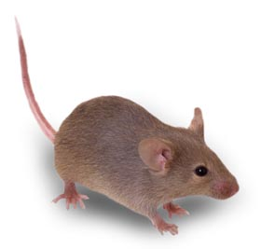
Bridging the gap
PubMed
Medical Informatics
Bioinformatics
Human Variation Databases
Model Organism Databases
Patient Records
OMIM
  3100 phenotype descriptions with molecular basis known
  3600 phenotype description or locus with basis unknown
Orphanet
  6000 diseases with phenotype descriptions
dbGaP
ClinVar
GWAS central
GWAS catalog
Mouse Genome Informatics
  >8800 genes have phenotype annotations in the mouse
Phenome DB
  1300 strains to date
Europhenome
International Mouse Phenotyping Consortium
  >1300 strains systematically phenotyped to date
Clinical Trials

Slide 26
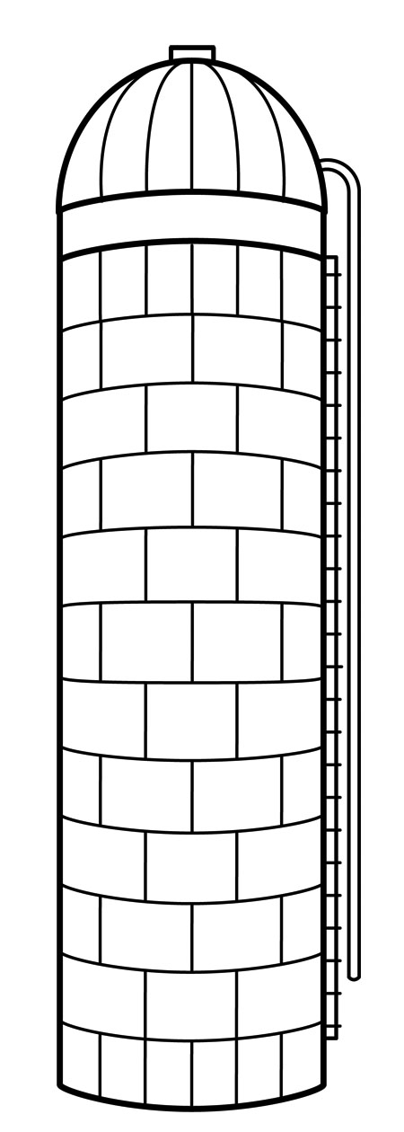
Data silos
FMA
Human development (EGDAA2)
pharyngeal region
organ system
solid organ
respiratory primordium
is_a (SubClassOf)
part_of
develops_from
surrounded_by
respiratory system
parenchymatous organ
lung bud
lung
Mouse Anatomy (MA)
Lower respiratory tract
lobular organ
thoracic cavity
organ system
Mammalian Phenotype(MPO)
abnormal respiratory system morphology
thoracic cavity organ
respiratory system
pleural sac
lung
abnormal lung morphology
lung
abnormal pulmonary acinus morphology
pulmonary acinus
abnormal pulmonary alveolus morphology
lung
alveolus
alveolar sac
Genome Biology 2012 13:R5

